Slide 1

General Information on
Doctoral Studies
Gödöllő and Buda Campus
September, 2021

Slide 2
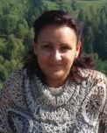
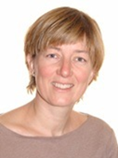
ADMINISTRATION: Who to contact (Gödöllő and Buda)?
Colleagues at DHC and at the student hostel
Mónika TÖRÖK-HAJDÚ
Head of DHC
Doctoral and Habilitation Centre, Gödöllő
Zsuzsanna TASSY
international coordinator
Doctoral and Habilitation Centre, Gödöllő
–––––––––––––––––––––––––––––––––––––––––––––––––––––––––––––––––––––––––––––––––––––––––––––––––––––––––––––––––––––

Slide 3
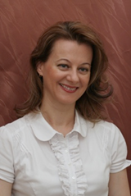
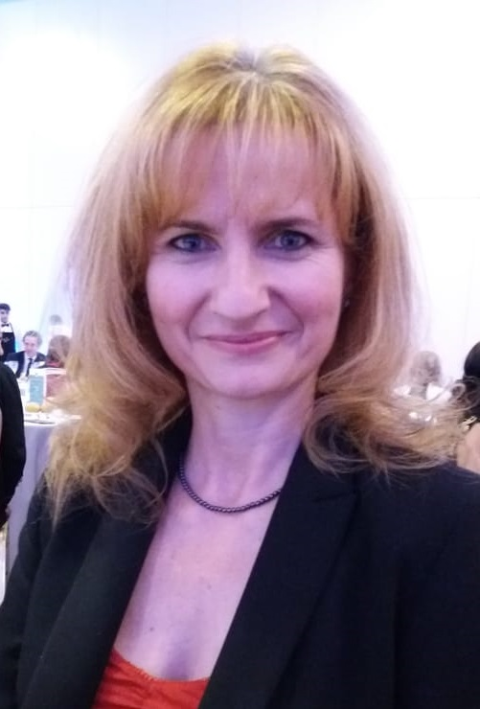
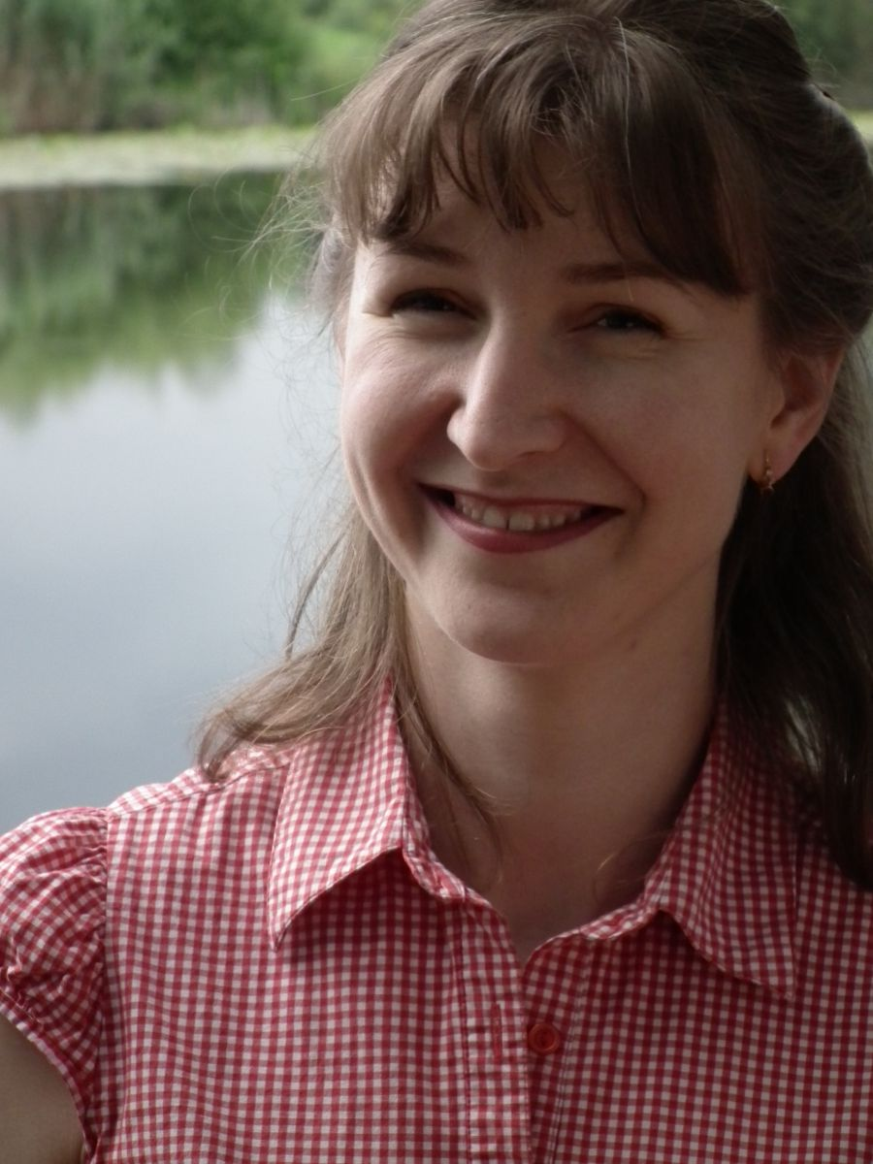
Colleagues at International Centre (IC)
Dr. Zsuzsanna TARR
Director of International Relations Centre
Csilla KÁNAI
Stipendium H., SCYP institutional Coordinator
Judit TALLÁROM CZINGILI
Student Services: Non-academic administration
Main building, ground floor room 29-31

Slide 4
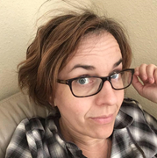
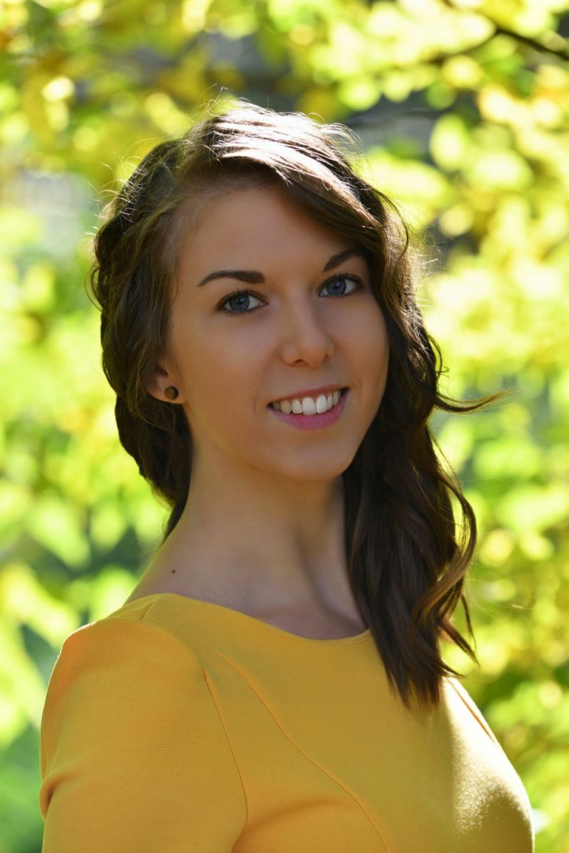
Colleagues at dormitory
Beáta KÁRPÁTI
student coordinator
Gödöllő Dormitory
Lilla GILIÁN
student coordinator
Gödöllő Dormitory

Slide 5
KEY SOURCES OF INFORMATION
HOMEPAGES: https://uni-mate.hu/en and
https://doktori.hu/
FACEBOOK: join „International students at MATE (former SZIU)” and „International PhD students MATE (former SZIU)” groups
SH/SCYP contracts for SH/SCYP scholarship holders (max. 2 passive semesters)
Rules and procedures:
  Doctoral rules of MATE: https://uni-mate.hu/en/phd/regulations

Slide 6
Structure of PhD programme
Year 1 | Study and research phase: - Courses - Literature review - Research, - Development of final research work plan 90-120 credits
Year 2
Mid-term/Complex Exam – Application for Complex Exam via Neptun!
Year 3 | Research and dissertation phase: - Research - Publications 120-150 credits
Year 4
Final certificate – 240 credits (absolutorium)
Defence

Slide 7
Mid-term (Complex) exam 1.
„theoretical exam part”
2 subjects, defined for the students
(usually from the list of courses)
„thesis related part”
Scholars have to report on the progress of literature review, and project planning and initial research activities

Slide 8
Mid-term (Complex) exam 2.
Registration required (via Neptun)
Supervisor’s recommendation necessary
It is a public event
Exam Committee: minimum 3 members
The chair is a professor
All members hold PhD degree
Supervisor present, but not member, does not vote

Slide 9
Mid-term (Complex) exam 3.
The 2 parts are evaluated individually
Evaluation: passed / fail
Descriptive assessment will be issued on the spot
Both parts have to be successful
The theoretical part can be resit once. If the thesis part fails the programme is terminated.

Slide 10
Terms of PhD decree
successful mid-term exam,
240 credits
obtaining the final certificate (absolutorium),
documentation of the independent scientific work according to the DS rules (publication)
Defending the results and thesis in a public discussion (defence)

Slide 11
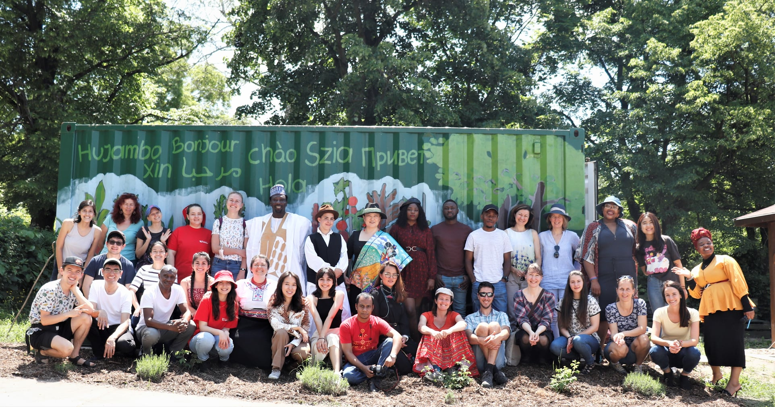
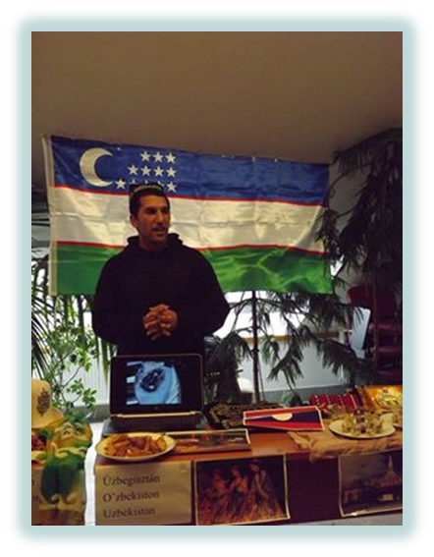
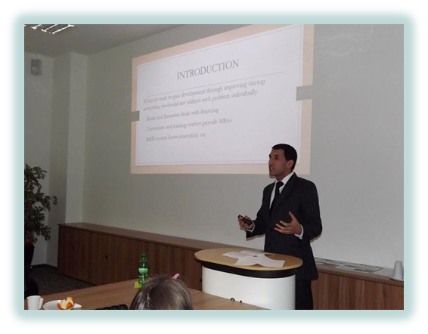
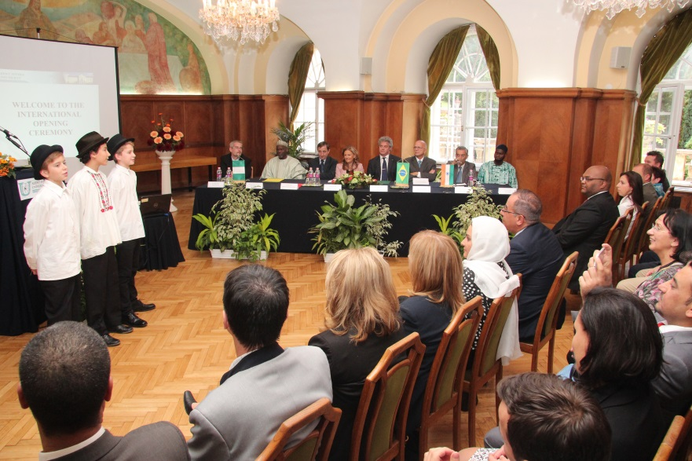
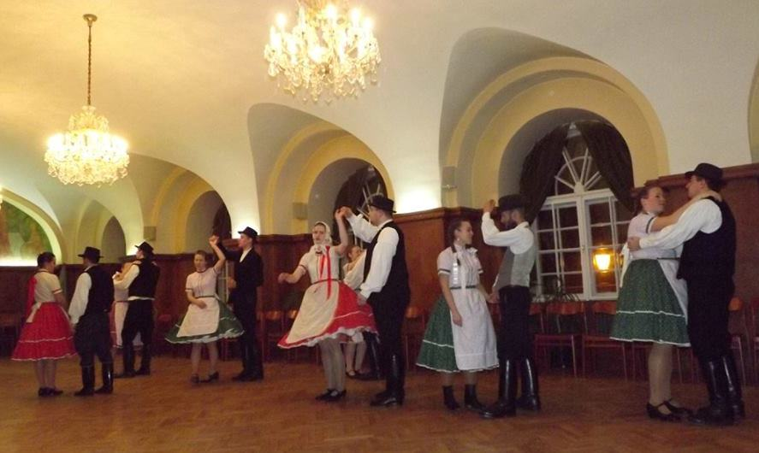
Programmes
for
international students
Orientation Week
Researcher’s Night
International Opening Ceremony
Cultural events (international dinner, Hungarian folkdance teaching, sports competitions etc.)
Hungarian language course is offered
Plant, farm visits
Participation on scientific conferences
Community garden in Gödöllő (grow your own veggies and herbs): https://www.facebook.com/SZIA-Agroecological-Garden-of-MATE-112538517117241/

