Slide 1
General Information on
Doctoral Studies
September, 2021

Slide 2
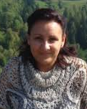
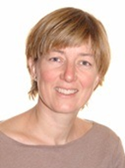
ACADEMIC ADMINISTRATION: Who to contact?
Doctoral and Habilitation Centre
Gödöllő
Mónika TÖRÖK-HAJDÚ
Head of DHC
torokne.hajdu.monika@uni-mate.hu
Zsuzsanna TASSY
international coordinator
tassy.zsuzsanna@uni-mate.hu
–––––––––––––––––––––––––––––––––––––––––––––––––––––––––––––––––––––––––––––––––––––––––––––––––––––––––––––––––––––

Slide 3
ADMINISTRATION: Who to contact?
Doctoral and Habilitation Centre
Buda Campus
Zsuzsanna TASSY
international coordinator
tassy.zsuzsanna@uni-mate.hu
Kaposvár Campus
Katalin LACZKÓ
international coordinator
laczko.lorantne@uni-mate.hu
Keszthely (Festetich Campus)
Mercédesz BUDAI-KONCZ
International coordinator
budai.koncz.mercedesz@uni-mate.hu
–––––––––––––––––––––––––––––––––––––––––––––––––––––––––––––––––––––––––––––––––––––––––––––––––––––––––––––––––––––

Slide 4
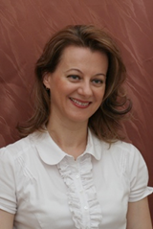
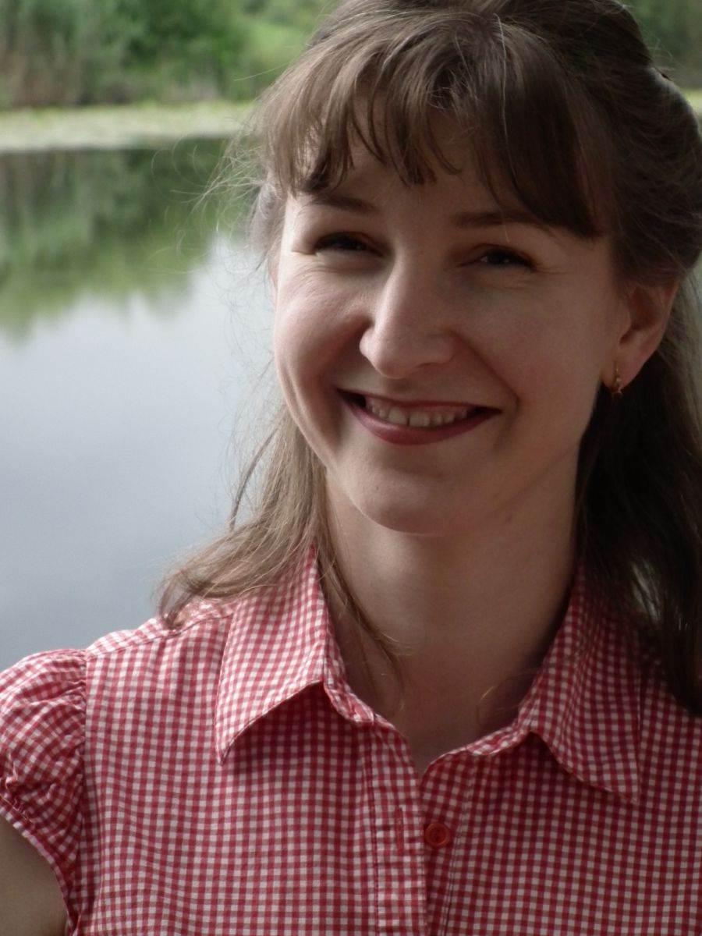
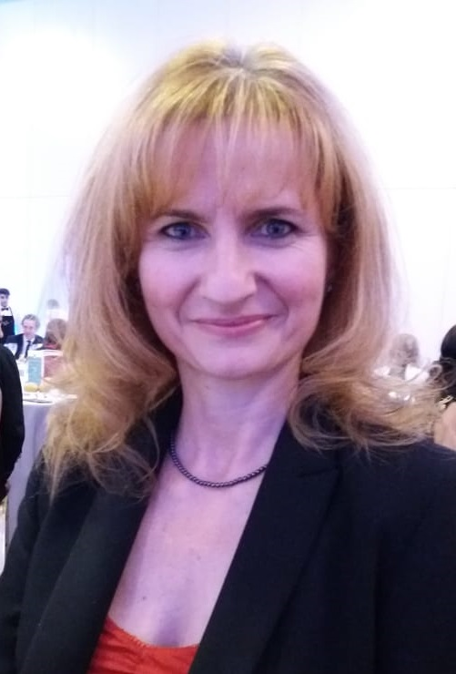
NON-ACADEMIC ADMINISTRATION: Who to contact?
International Centre
Gödöllő Campus
Dr. Zsuzsanna TARR
Director of International Relations Centre
Tarr.zsuzsanna@uni-mate.hu
Judit TALLÁROM CZINGILI
Student Services: Non-academic administration
Main building, ground floor room 29-31
Tallaromne.czingili.judit@uni-mate.hu
Csilla KÁNAI
Stipendium H., SCYP institutional coordinator
Kanai.csilla@uni-mate.hu

Slide 5
NON-ACADEMIC ADMINISTRATION: Who to contact?
International Centre
Buda Campus
Orsolya NAGY
international coordinator
nagy.orsolya@uni-mate.hu
Kaposvár Campus
Haán László
International coordinator
Haan.laszlo@uni-mate.hu
Keszthely (Festetich Campus)
Adrienn Soós
International coordinator
soos.adrienn@uni-mate.hu

Slide 6
KEY SOURCES OF INFORMATION
HOMEPAGES: https://uni-mate.hu/en and
https://doktori.hu/
FACEBOOK: join „International students at MATE (former SZIU)” and „International PhD students MATE (former SZIU)” groups
SH/SCYP contracts for SH/SCYP scholarship holders (max. 2 passive semesters)
Rules and procedures: Doctoral Rules at MATE (https://archive.uni-mate.hu/en/phd/regulations)
Official Hungarian site of scientific publications: MTMT Registration is compulsory for PhD students
Info: MATE libraries or molnar.szilvia@uni.mate.hu

Slide 7
Structure of PhD programme
Year 1 | Study and research phase: - Courses - Literature review - Research, - Development of final research work plan min. 90-120 credits (depending on DS)
Year 2
Mid-term/Complex Exam – Application for Complex Exam via Neptun!
Year 3 | Research and dissertation phase: - Research - Publications min. 120-150 credits
Year 4
Final certificate – 240 credits (absolutorium)
Defence

Slide 8
Mid-term (Complex) exam 1.
„theoretical exam part”
2 subjects, defined for the students (usually from the list of courses)
„thesis related part”
Scholars have to report on the progress of literature review, and project planning and initial research activities

Slide 9
Mid-term (Complex) exam 2.
Registration required (via Neptun)
Supervisor’s recommendation necessary
It is a public event
Exam Committee: minimum 3 members
The 2 parts are evaluated individually
Evaluation: passed / fail
Descriptive assessment will be issued on the spot
Both parts have to be successful
The theoretical part can be resit once. If the thesis part fails the programme is terminated.

Slide 10
Terms of PhD decree
successful mid-term exam,
240 credits = obtaining the final certificate (absolutorium),
documentation of the independent scientific work according to the DS rules (publication)
Defending the results and thesis in a public debate (defence)

Slide 12
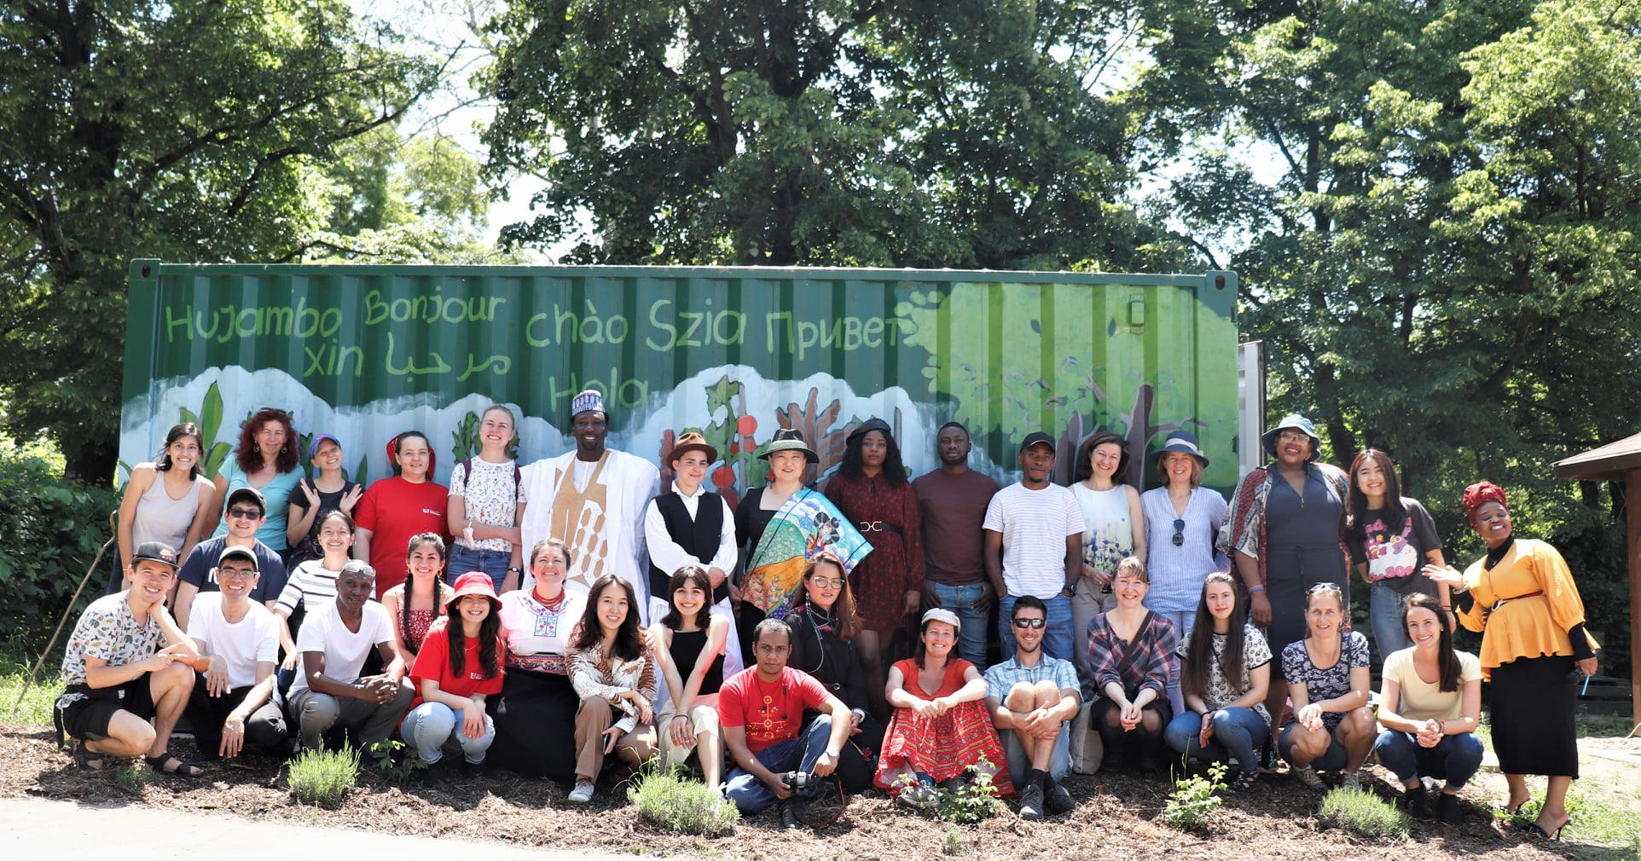
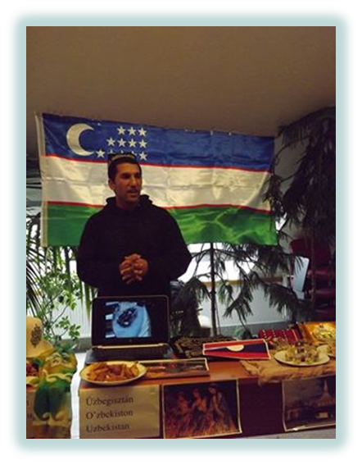
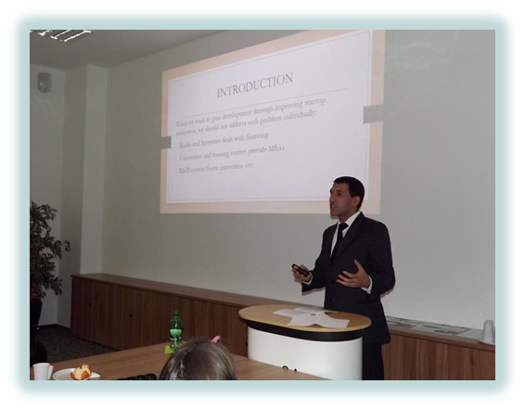
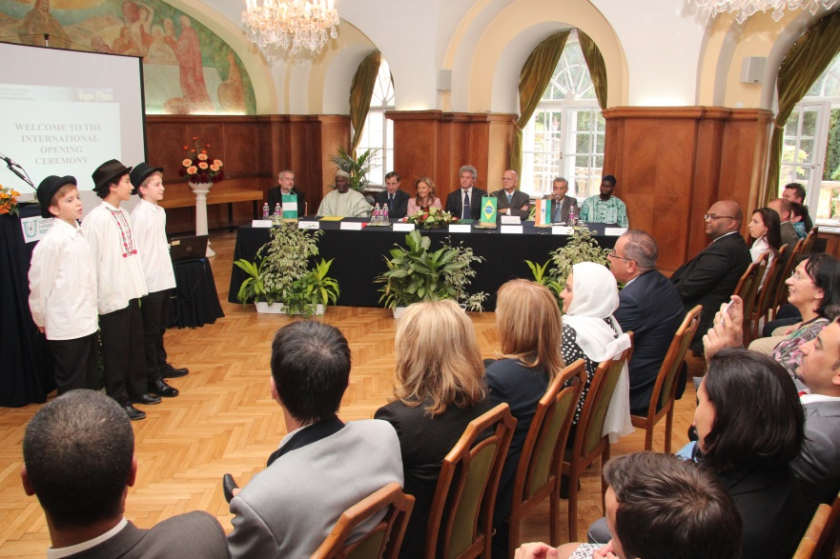
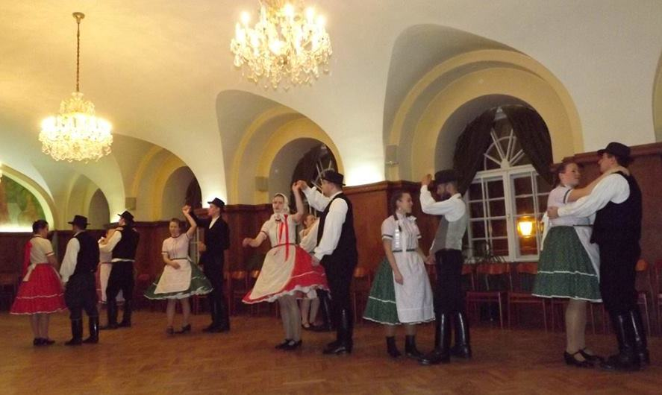
Programmes
for
international students
Orientation Week
Researcher’s Night
International Opening Ceremony
Cultural events (international dinner, Hungarian folkdance teaching, sports competitions etc.)
Hungarian language course is offered
Plant, farm visits
Participation on scientific conferences
Community garden in Gödöllő (grow your own veggies and herbs): https://www.facebook.com/SZIA-Agroecological-Garden-of-MATE-112538517117241/

